Slide 1


Vision Diagrams Series Communication Compliance
Thierry Matusiak Information Security Architect
aka.ms/thierry
Public Version : 2025-03-11

Slide 2
Communication Compliance
monitors users interactions to raise alerts
Foreword : this technical presentation aims at summarizing the functional architecture of the Communication Compliance module.
This presentation is not intended to present Communication Compliance business value or the challenges it helps to address. Refer to the online documentation or introductory decks to discover the Purview Communication Compliance module.
Communication Compliance

Slide 3
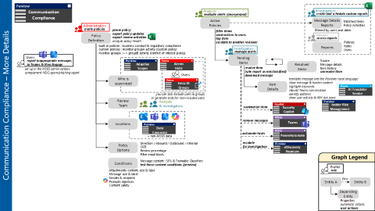
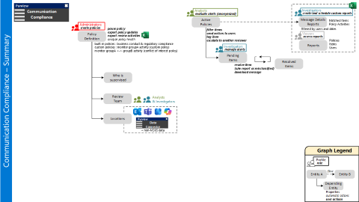
Communication Compliance
monitors users interactions to raise alerts
Communication Compliance
Summary
More Details

Slide 4
Communication Compliance – Summary

Slide 5

Summary – Step by Step
Communication Compliance – Summary
Administrators define a set of policies.
Who should be monitored ?
Who is in charge of reviewing alerts ?
Which channels should be inspected ?

Slide 6
Active policies identify alerts (called “items”).
Analysts evaluate them.
Investigators manage and resolve items.
Communication Compliance – Summary

Slide 7
Communication Compliance provides reports.
Viewers access these reports.
Investigators can create complementary reports.
Communication Compliance – Summary

Slide 8
Communication Compliance – More Details

Slide 9
More Details – Step by Step
Administrators create policies.
They can also pause existing policies and export :
Policy updates
Policy Review Activities
Communication Compliance – More Details

Slide 10
Communication Compliance – More Details
Various options exist to specify who should be monitored.
a list of users
Entra ID groups
Both of them can be limited through Admin Units.
The Administrator may prefer to leverage an Adaptive Scope.

Slide 11
Communication Compliance – More Details
Administrators specify policy options,
plus the conditions that the policy should look for.

Slide 12
Communication Compliance – More Details
Communication Compliance provides detailed information for every identified Item.
It also integrates with Insider Risk Management to provide more details about user’s activity.
Items can be pending or resolved.

Slide 13
Communication Compliance – More Details
Investigators perform additional actions :
Summarize items
Remove messages from Teams
Launch Power Automate flows
Escalate serious alerts to eDiscovery cases

Slide 14
Users can report inappropriate messages.
They get captured into a specific CC policy.
Communication Compliance – More Details

Slide 15

Conclusion

Slide 16
Vision Diagrams Series Communication Compliance
INTERNAL VERSION
DO NOT RE-SHARE EXTERNALLY
Thierry Matusiak Information Security Architect
aka.ms/thierry

